Slide 1



Kidzy Launcher
A Safe, Interactive, and Educational Digital Environment
GROUP 4

Slide 2
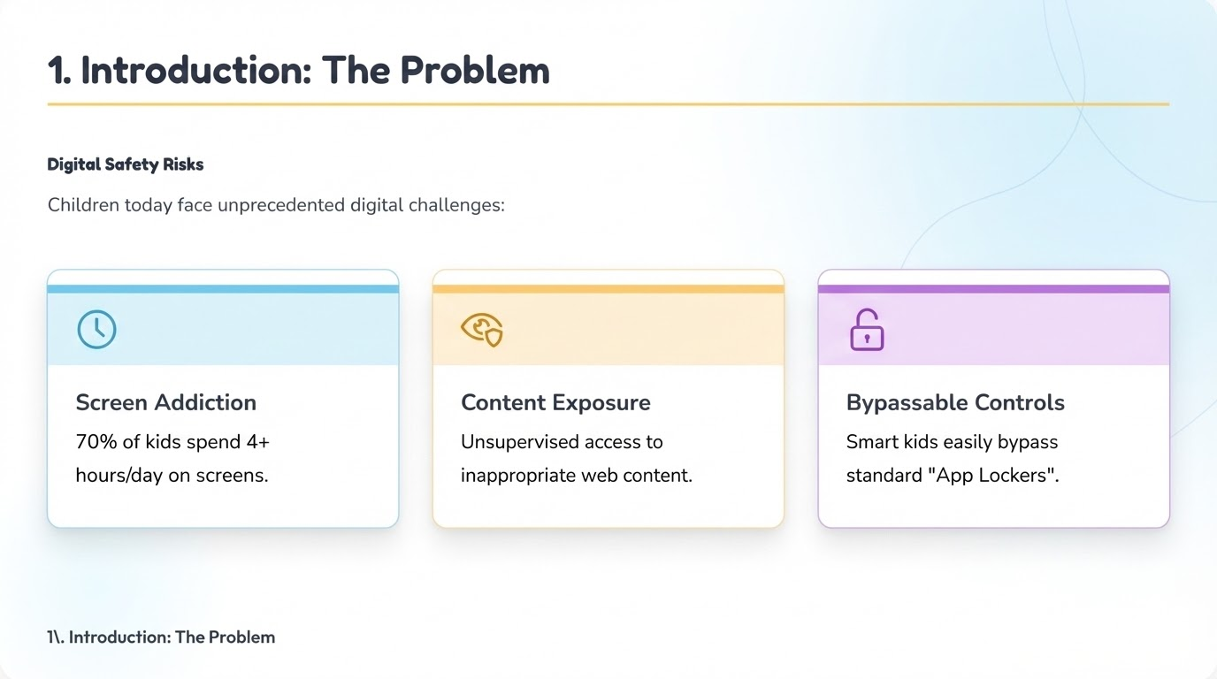

Slide 3
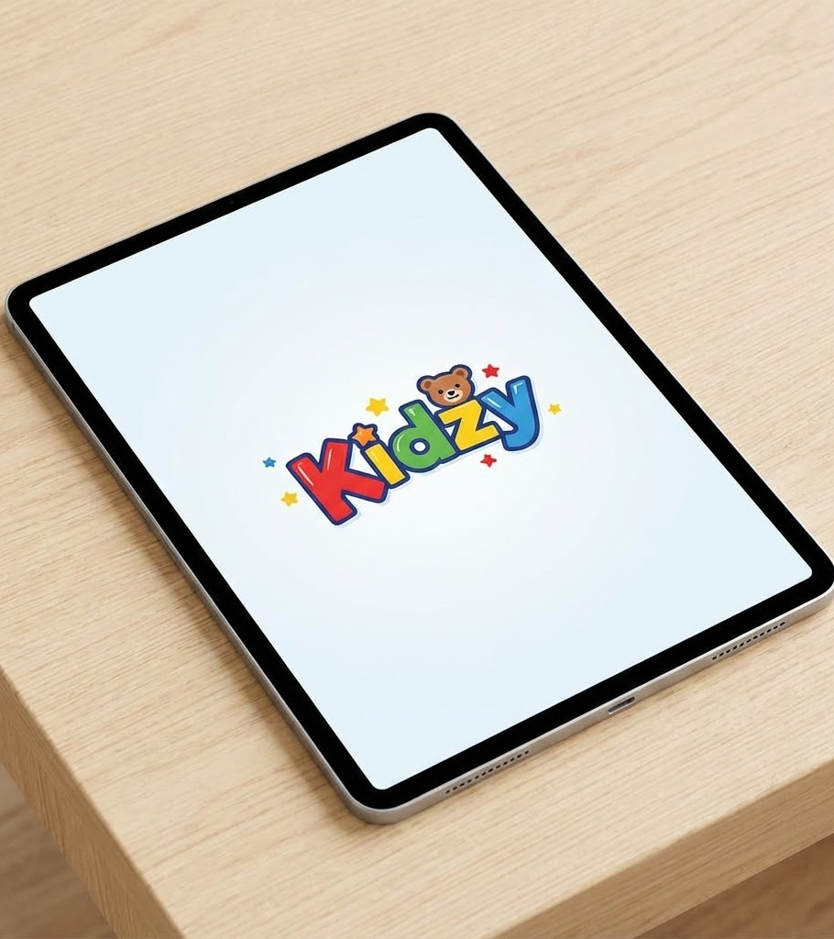
What is Kidzy?
Kidzy is a Launcher Application that completely replaces the standard home screen interface.
It transforms the device into a customized, child-friendly sandbox. It allows parents to control the environment remotely while providing kids with a fun, gamified AI assistant.

Slide 4




Our Philosophy
Kidzy is a partner, not a parent
An Active Space, Not a cage
A Mentor, Not a Monitor

Slide 5
Objectives
Safe Digital Environment
Educational Growth
Healthy Digital Habits

Slide 6
Stakeholders
Parent
Child
Development Team
Psychologists & Educational Experts
Policy & Compliance Experts

Slide 7

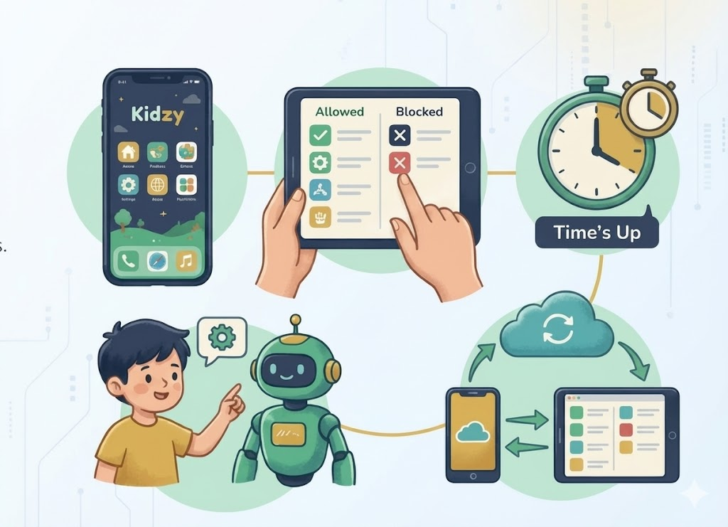
Functional Requirements
Essential Functions
FR1: System shall replace the default home screen.
FR2: Parent must be able to whitelist/blacklist apps.
FR3: System shall enforce daily screen time limits.
FR4: Child can customize their AI avatar.
FR5: Allow parents to send texts and reminders.
FR6: Enable the AI assistant to provide helpful reminders and warnings.
FR7: Include built-in educational tools.

Slide 8

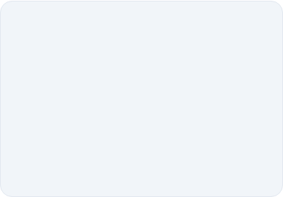




Non-Functional Requirements
Security & Privacy
Performance
Usability
Parent PIN must be encrypted. Child cannot uninstall the launcher without Admin credentials.
Launcher must load in < 2 seconds. Battery consumption must not exceed 5% per hour.
UI buttons large (min 48px) for children. Text must be readable.

Slide 9
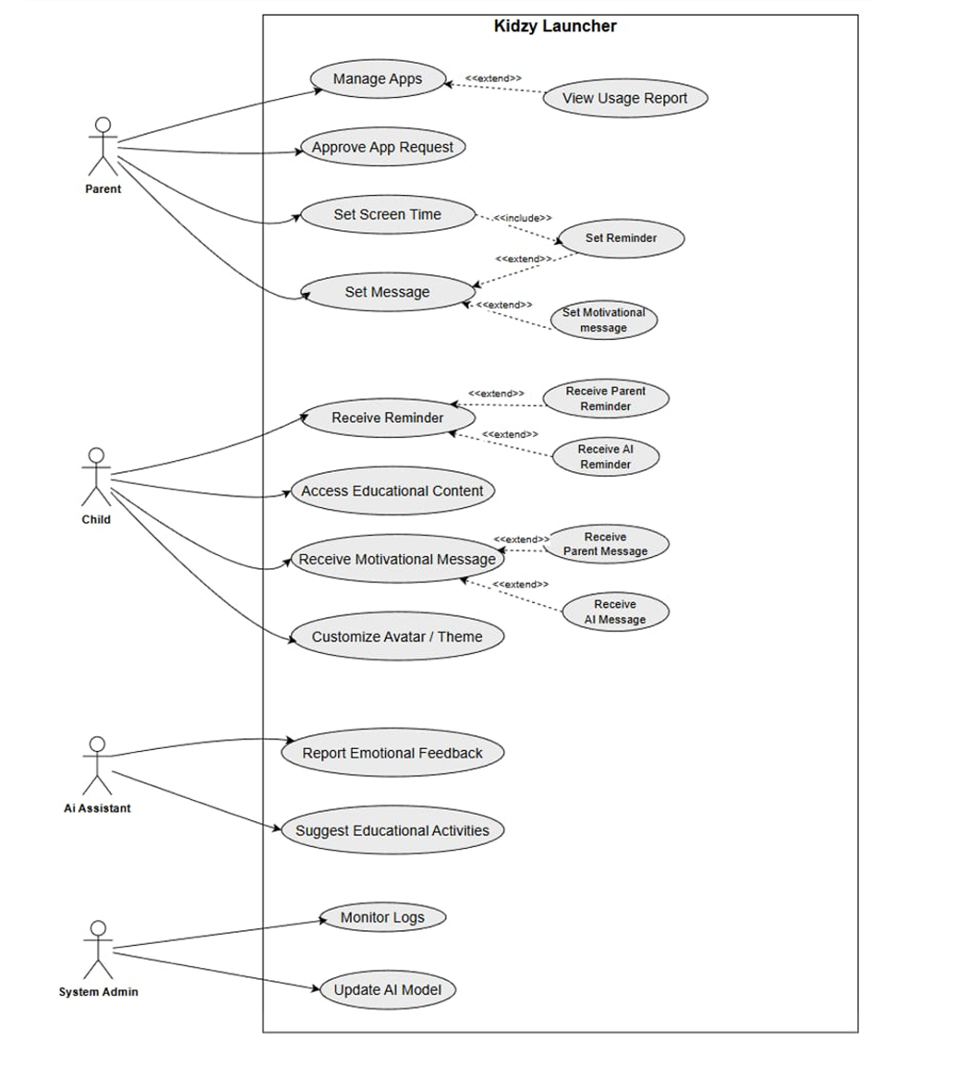
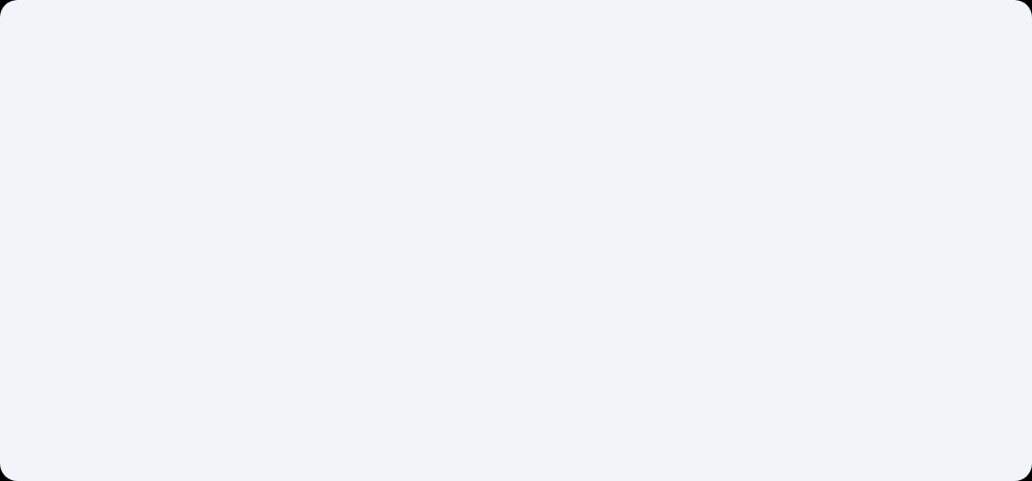
The Use Case Model Diagram
Parent controls apps and schedules.
Child accesses apps and receives messages.
AI Assistant monitors and suggests.
System Admin maintains the system.

Slide 10
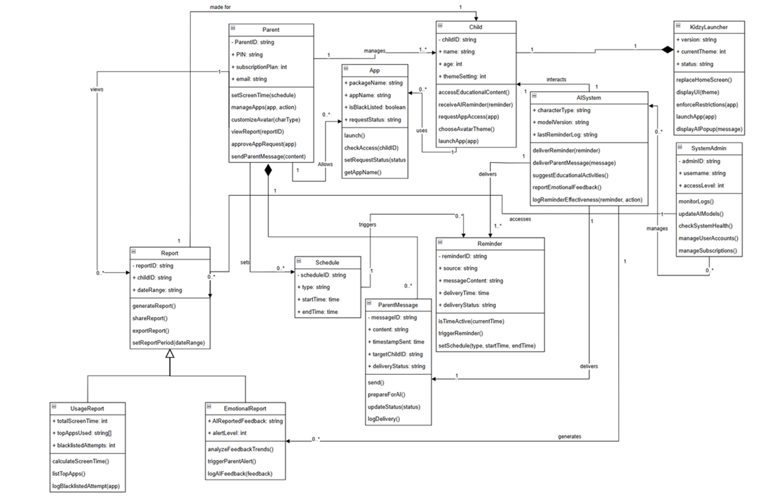
UML Class Diagram

Slide 11
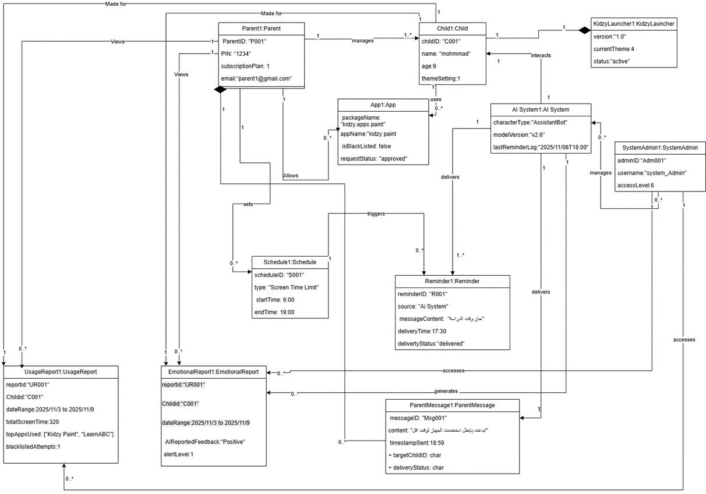
Object Diagram
:

Slide 12
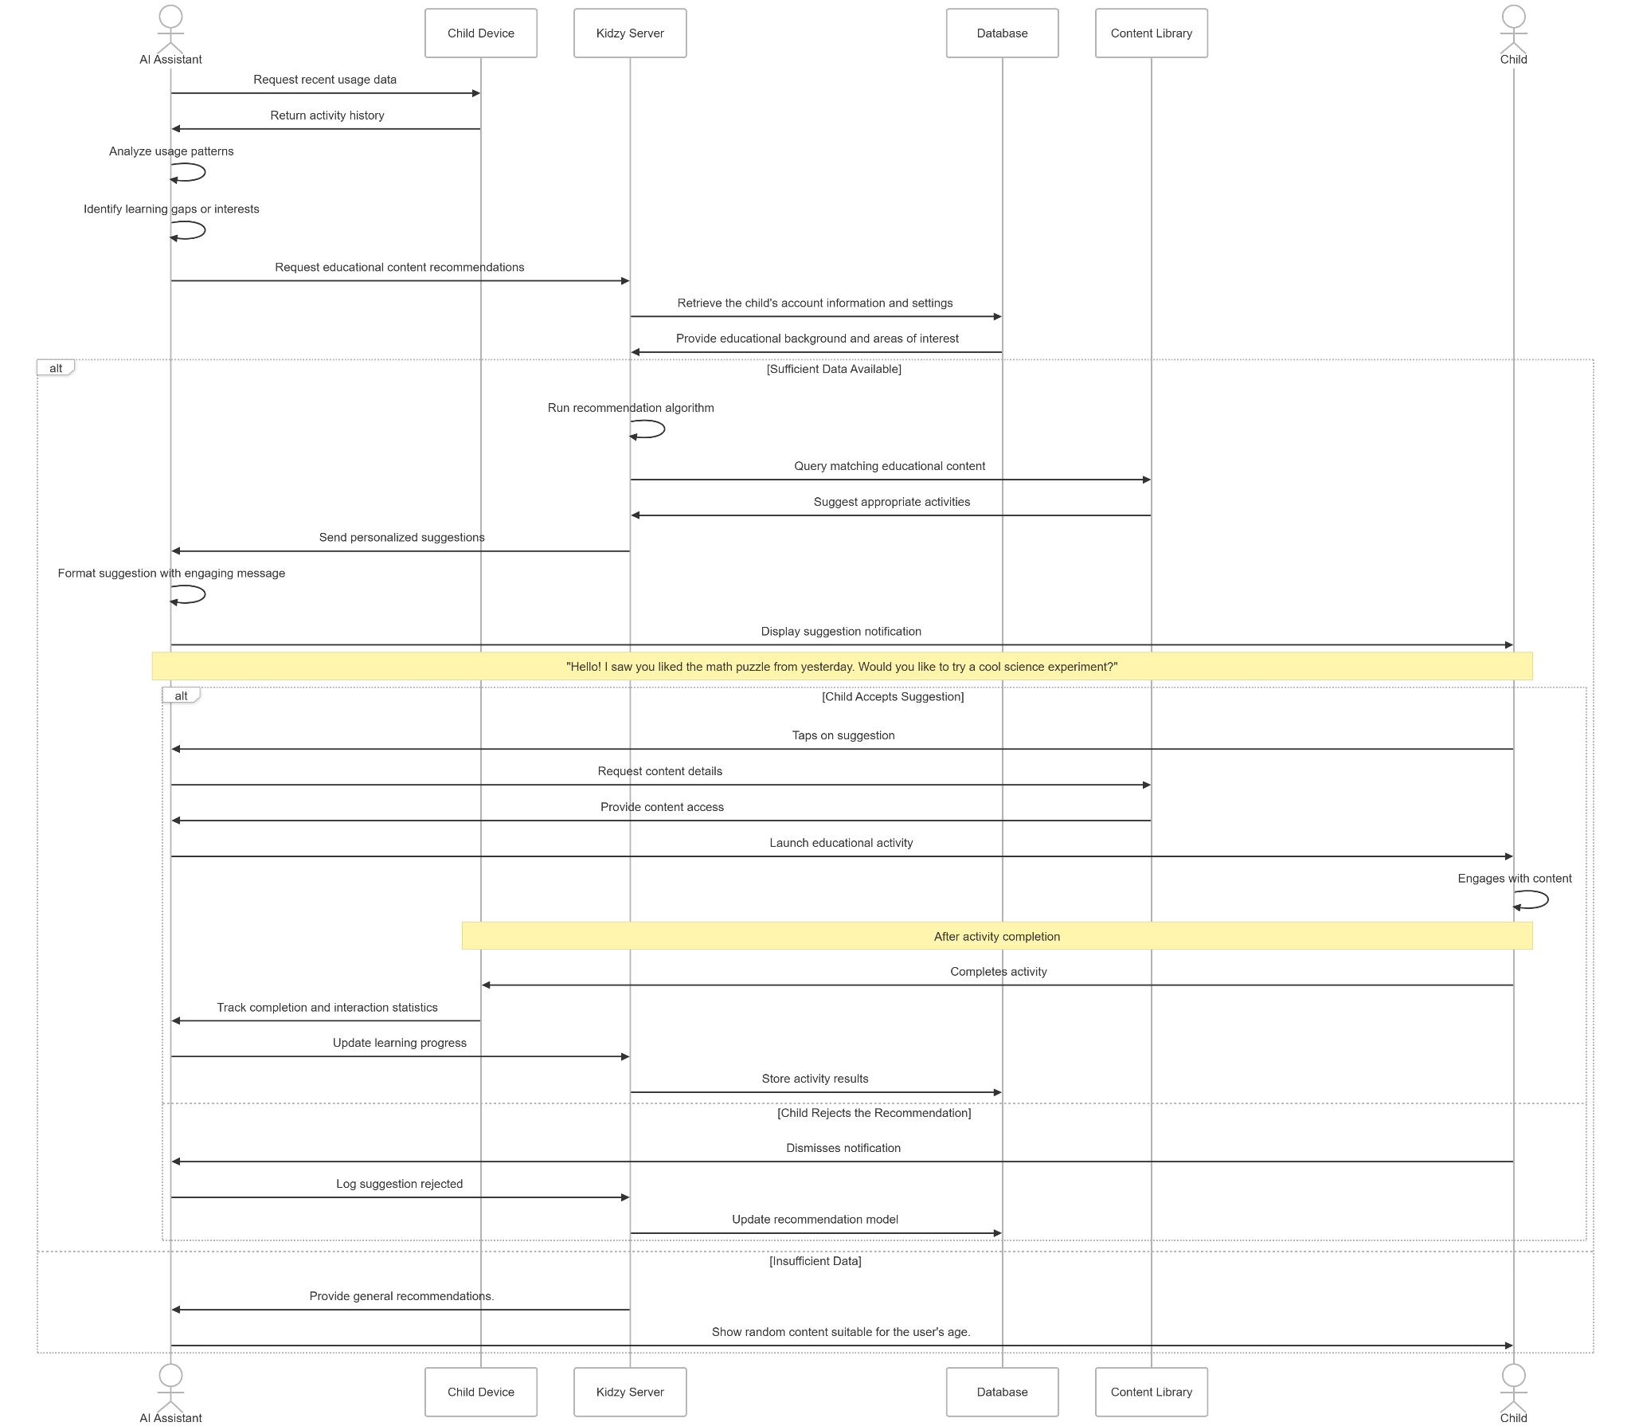
Sequence: AI Educational Suggestions

Slide 13
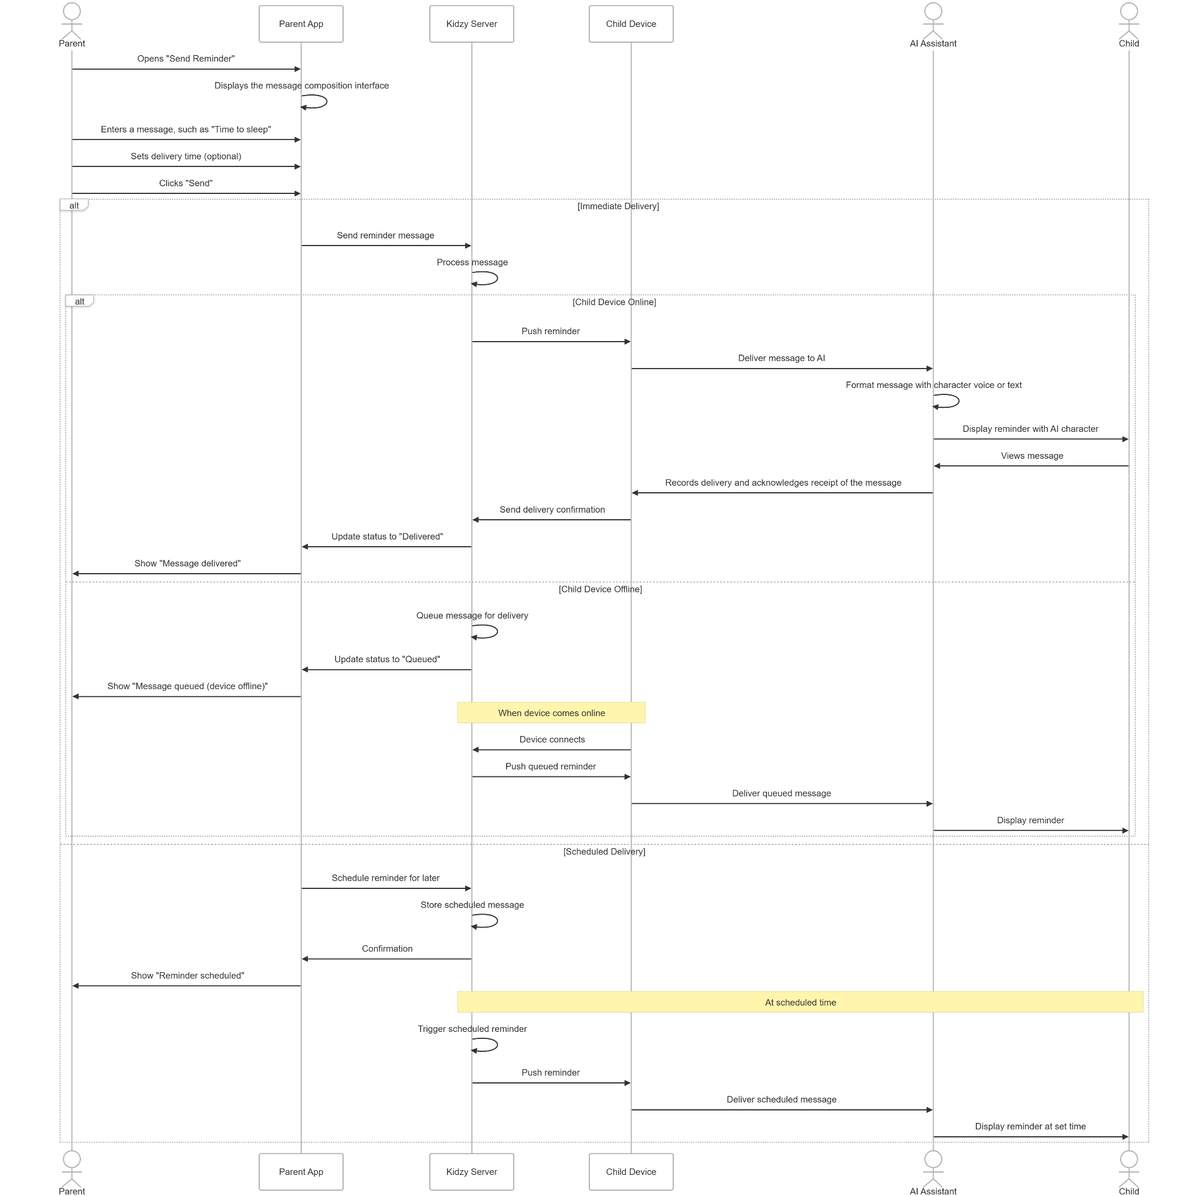
Sequence: Send & Receive Parent Reminder

Slide 14
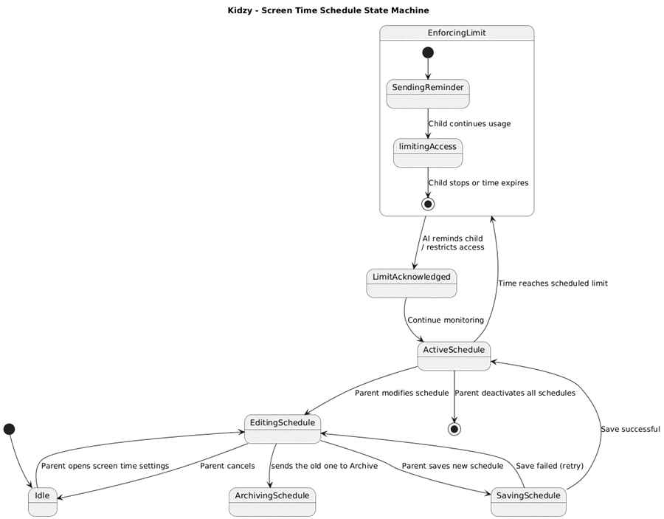
State Diagram: Screen Time Schedule

Slide 15
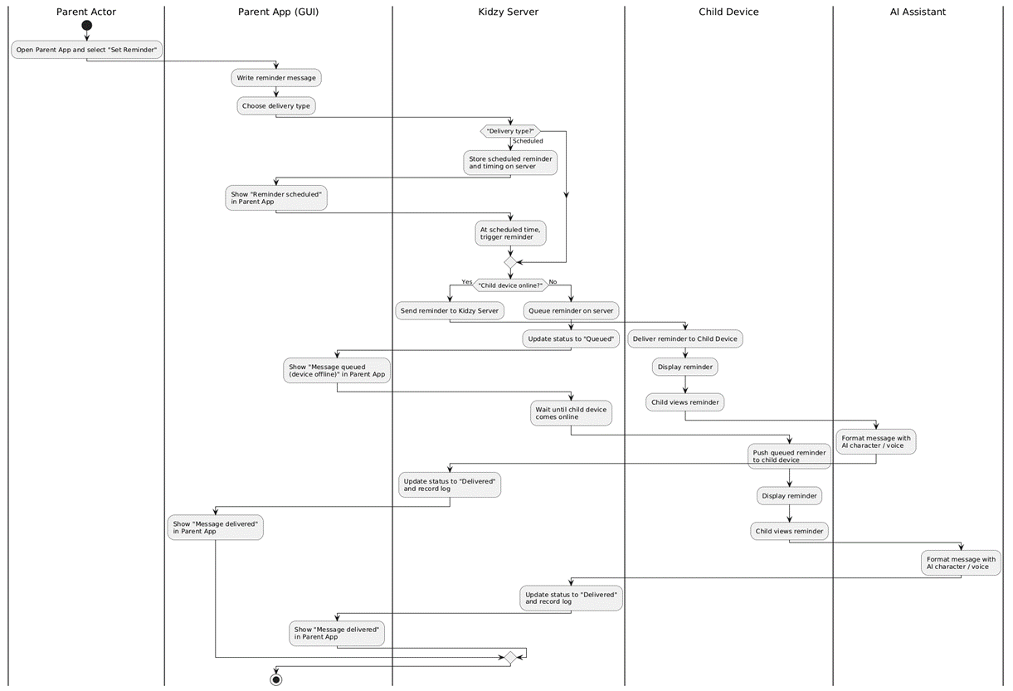
Activity Diagram

Slide 16
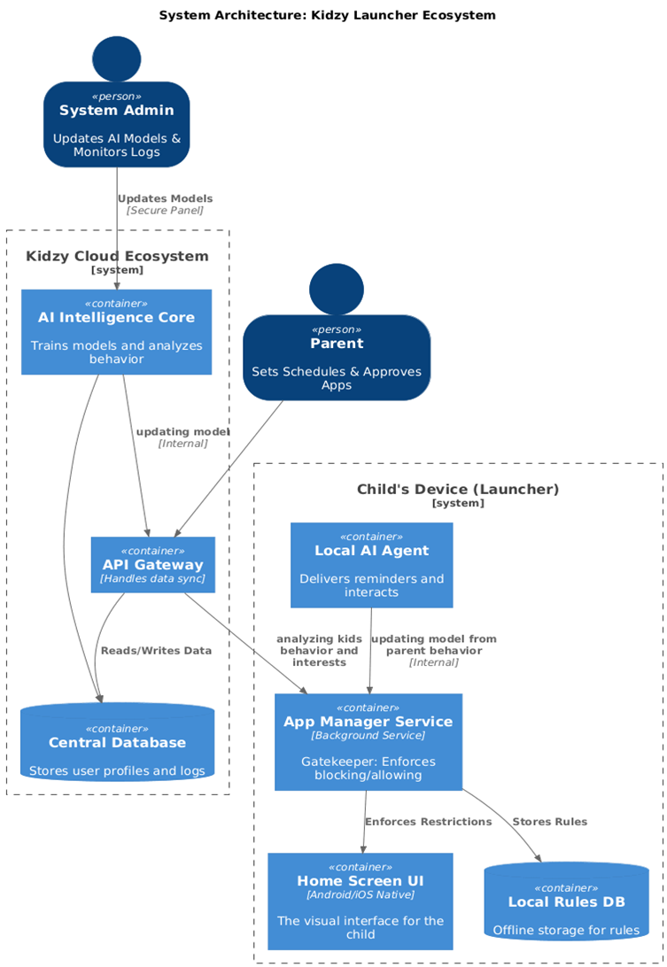
System Architecture
Client Server Model
Offline Availability
AI Core
Why A Launcher ?
Features | Application | Kidzy Launcher
System Role | Just a app running on the phone. | Manager of the device interface.
Home Button | Exits the app and returns to the main screen. | Reloads Kidzy (cant exit)
Access Control | Cannot prevent opening other apps. | Controls the door to all other apps
Permissions | Standard phone things(Camera, mic) | High level: device admin, system overlay

Slide 17
Testing Strategy
Functional Testing
UI Testing
Integration Testing
Test core behaviours such as managing apps, setting schedules, etc.
Ensure interfaces are simple and consistent and inputs are easy to perform
Ensure consistent communication between the app and servers
Performance Testing
Security Testing
Compatibility Testing
Examine the Responsiveness.
Latency: app blocking within 100ms.
Stress test: forcefully closing launcher 15 time in 1min
Ensure app blocking and PIN access are tamper resistant. Also ensure private logs are not leaked.
Test the app on multiple devices of varying screen size and age

Slide 18
Kidzy Vision
Multi Device Expansion
SmartWatch Integration
Advanced AI Models

Slide 19

Thank You!
Ammar Alamri : 2339570
Ahmad Alsaedi : 2339836
Hussain Abulnaja : 2340240
Majed Alsulami : 2339658
Sultan Alasmi : 2339663
Any questions about Kidzy?

